Slide 1

Algorithm Design and Analysis Chapter 34: NP-Completeness
School of Software Shandong University
2023

Slide 2
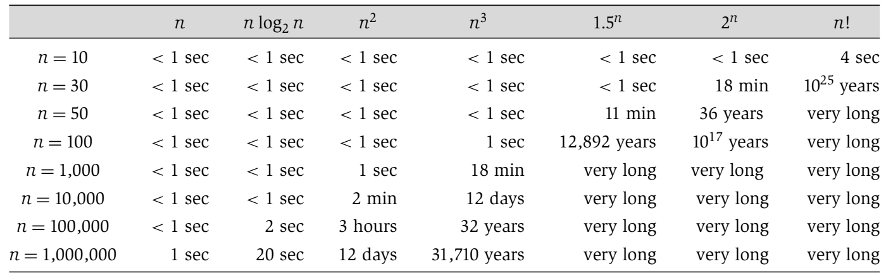
polynomial time
non-polynomial time

Slide 3
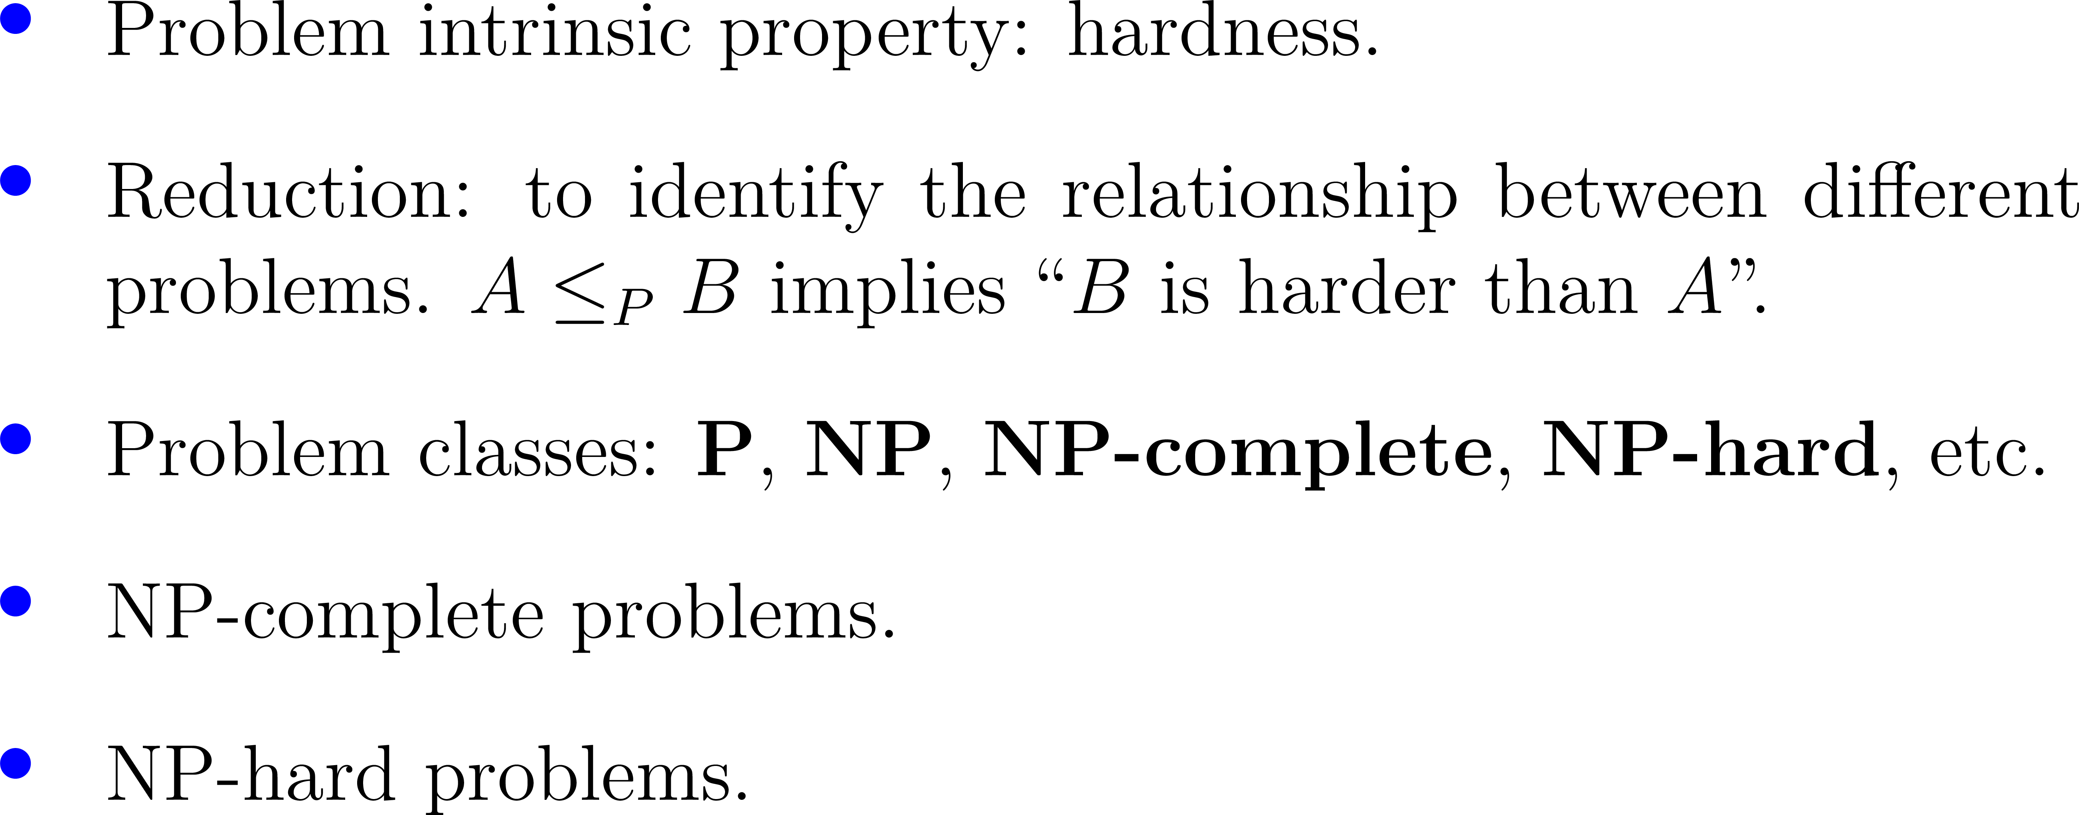
Outline

Slide 4
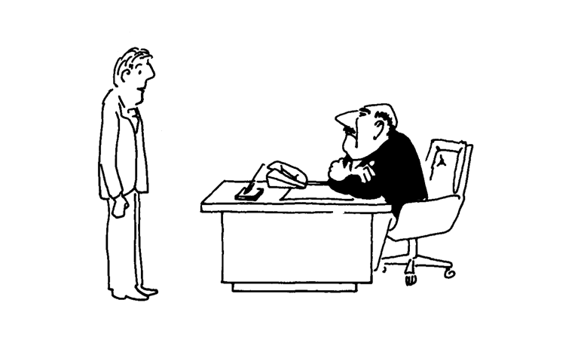
“Your task: a good method for determining whether or not any given set of specifications for a new product can be met and, if so, for constructing a design that meets them.”

Slide 5
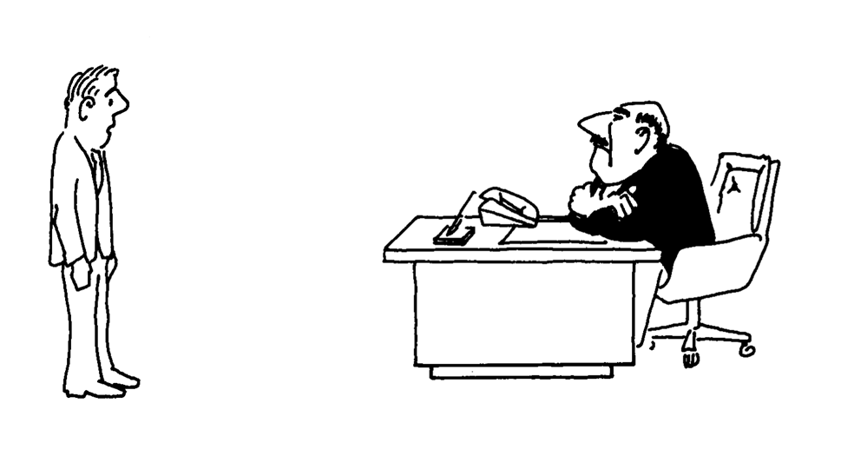
Before
studying NP-completeness :
“I can’t find an efficient algorithm, I guess I’m just too dumb.”

Slide 6
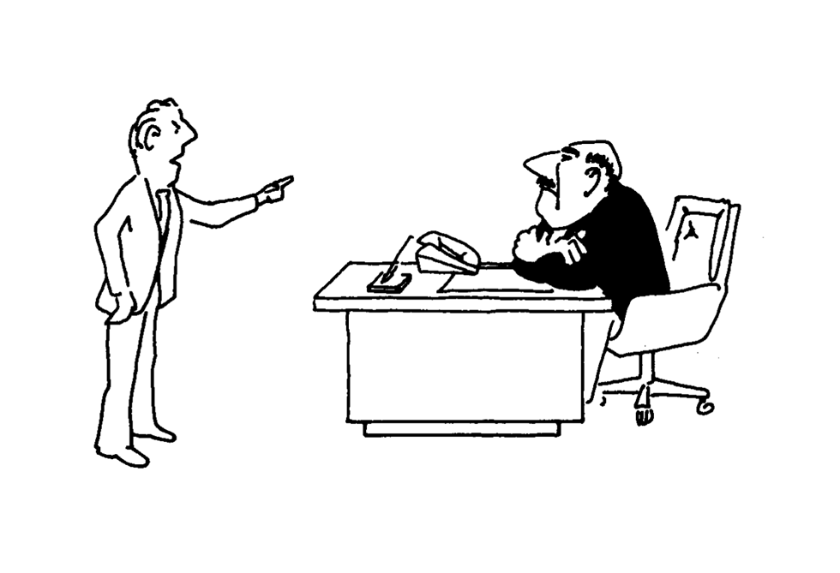
After
studying NP-completeness :
“I can’t find an efficient algorithm, because no such algorithm is possible !”

Slide 7
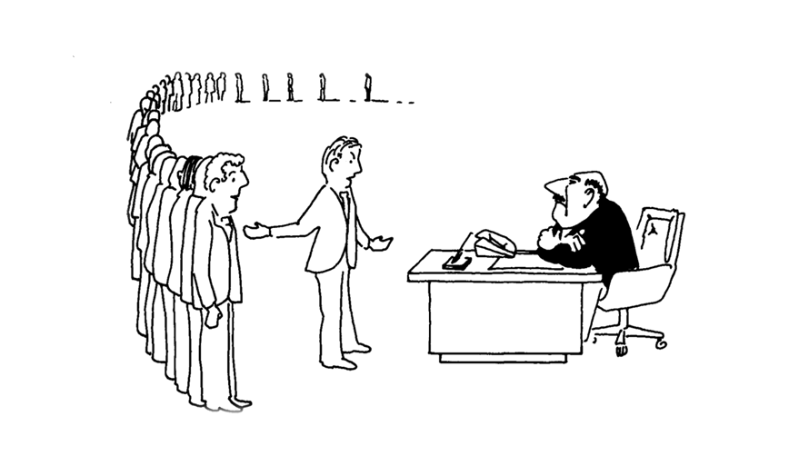
After
studying NP-completeness :
“I can’t find an efficient algorithm, but neither can all these famous people.”

Slide 9

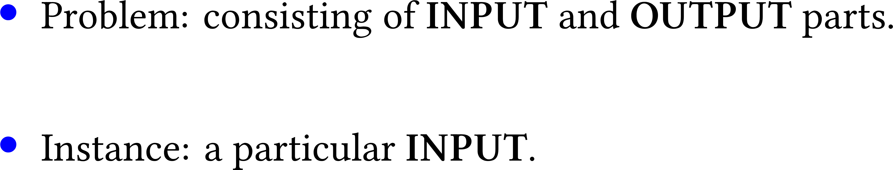

Slide 10






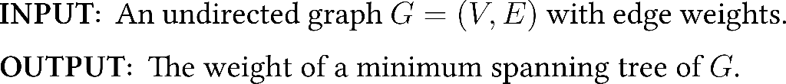



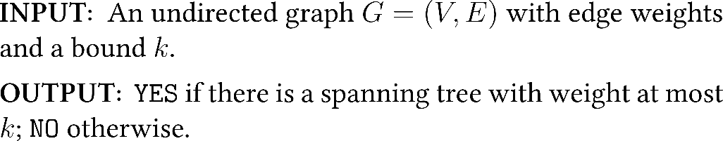

Slide 12
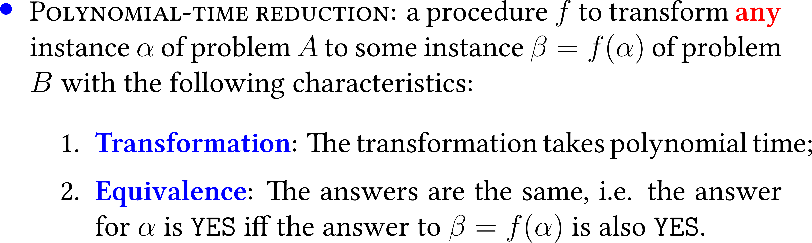



Slide 13


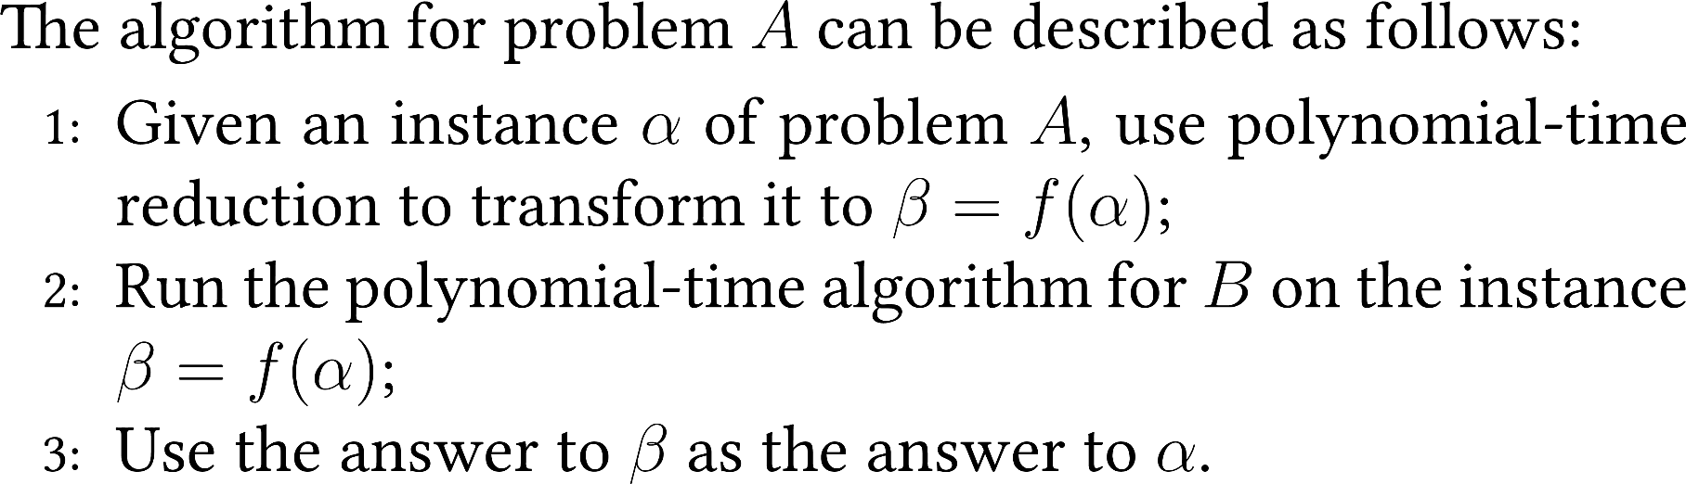

Slide 14

quiz
Suppose that X ≤ _{P} Y. Which of the following can we infer?
A. If X can be solved in polynomial time, then so can Y.
B. X can be solved in poly time iff Y can be solved in poly-time.
C. If X cannot be solved in polynomial time, then neither can Y.
D. If Y cannot be solved in polynomial time, then neither can X.

Slide 15


Slide 16

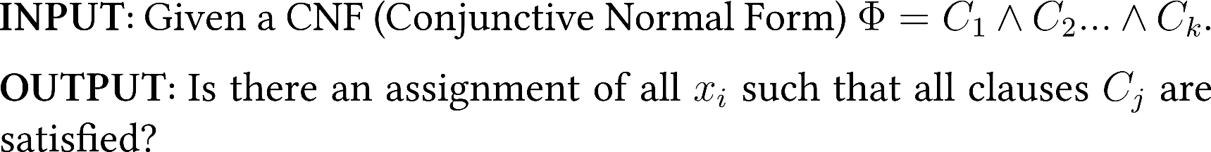




Slide 17
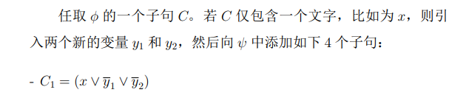
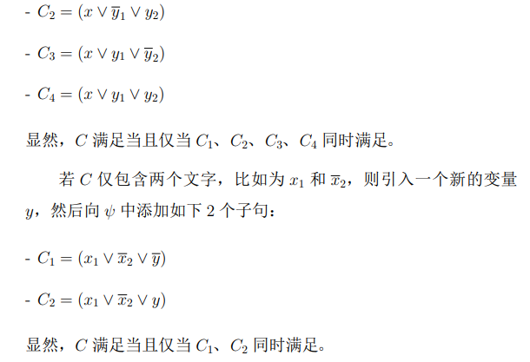

Slide 18


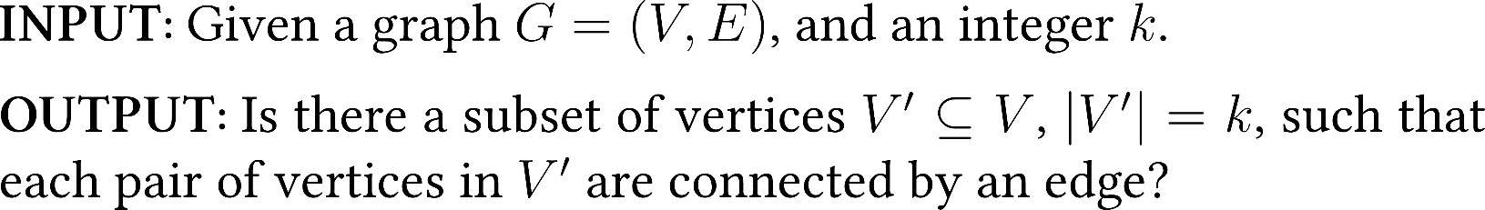
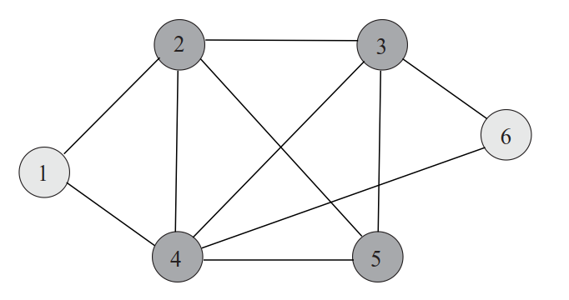

Slide 19
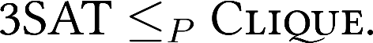


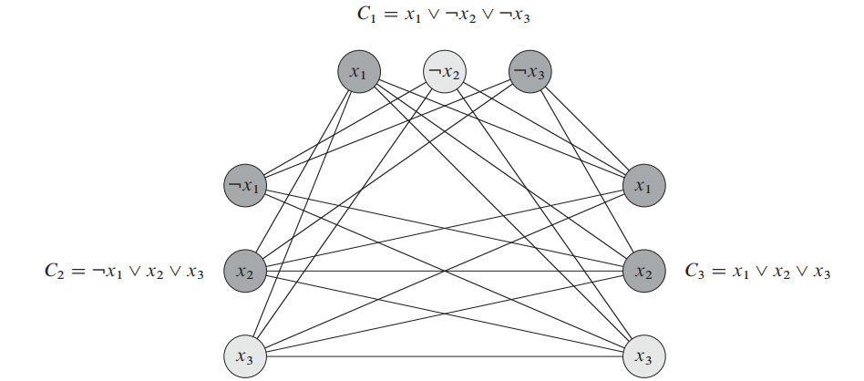

Slide 20




Slide 21


Slide 23

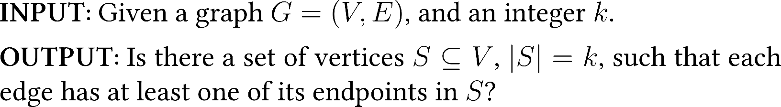
2
3
1
4
6
5

Slide 24
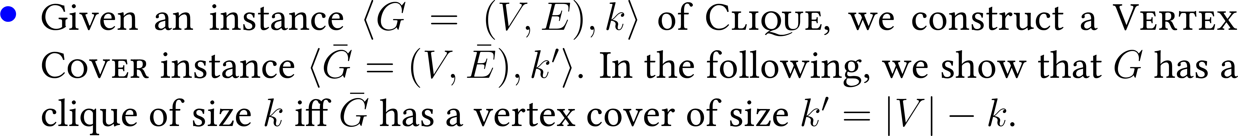
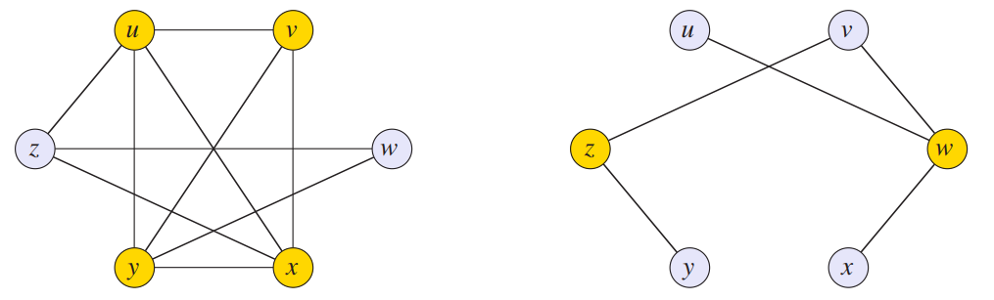

Slide 27


Slide 28


Slide 29

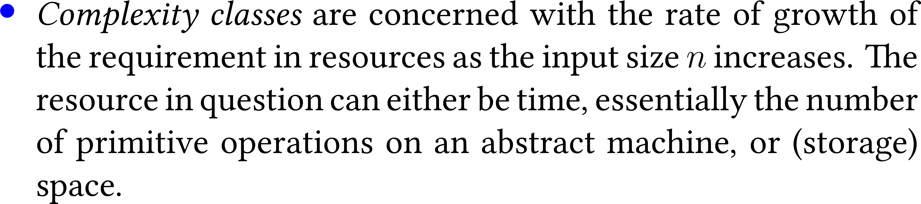
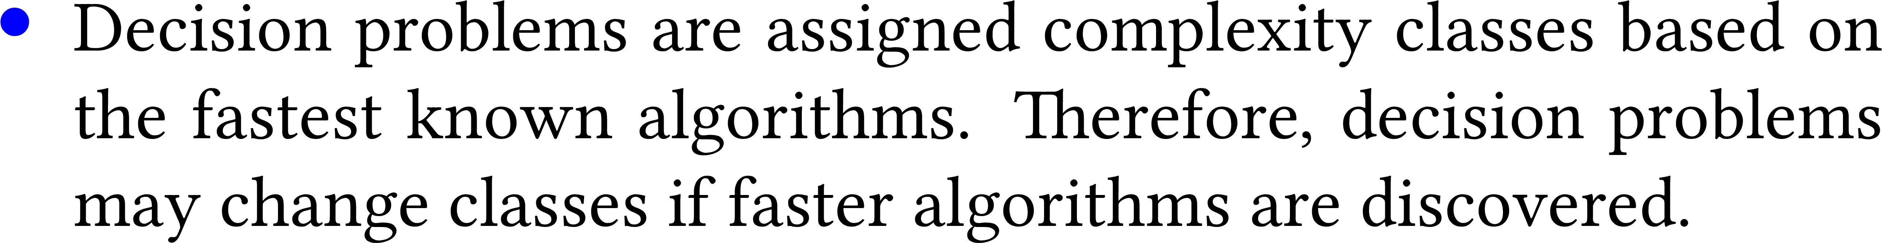

Slide 30


Slide 31


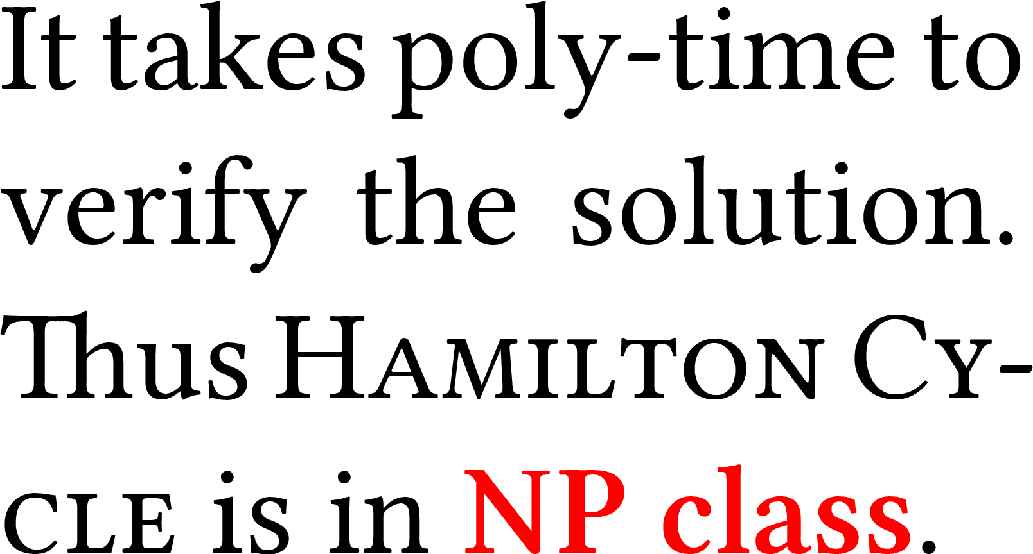
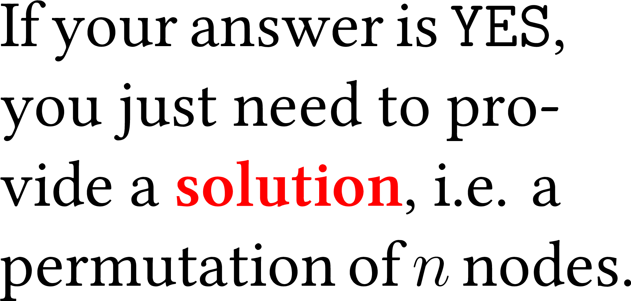
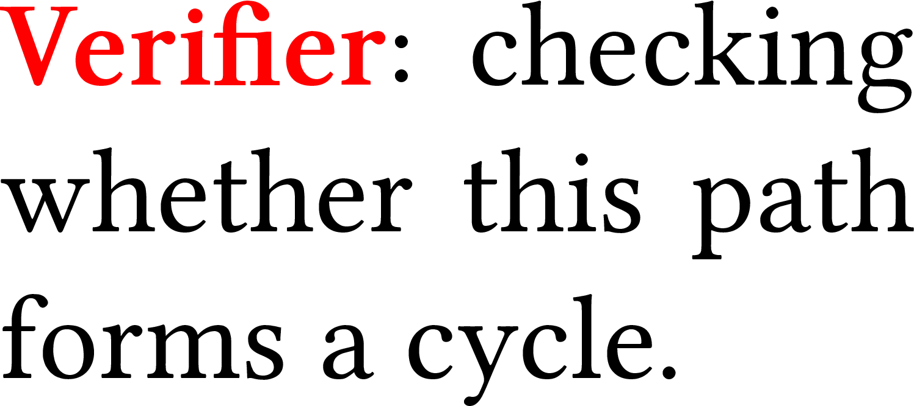

Slide 32
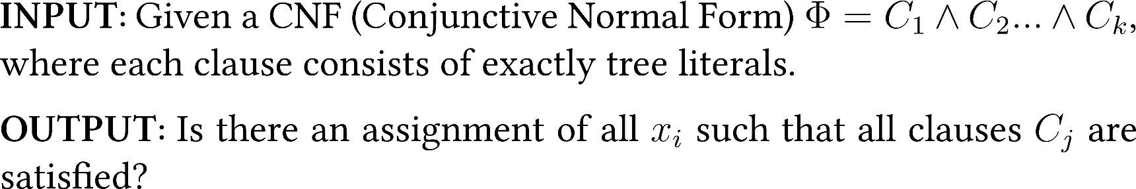


Slide 33
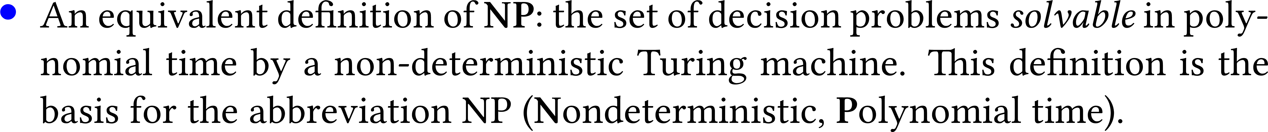
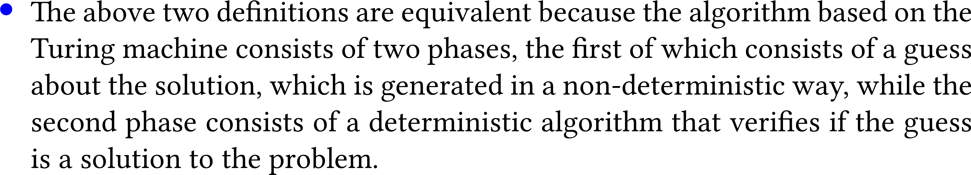

Slide 34



Slide 35

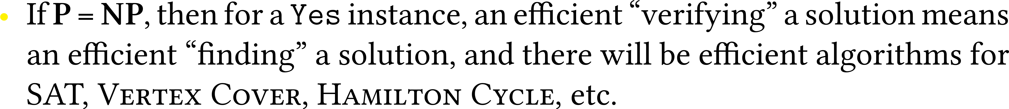
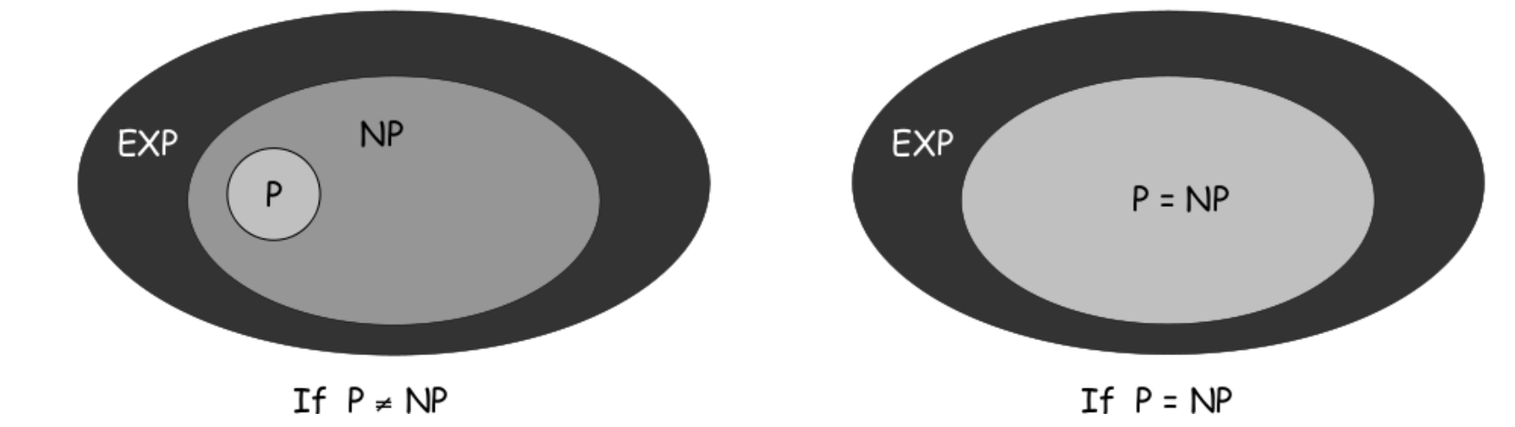

Slide 36

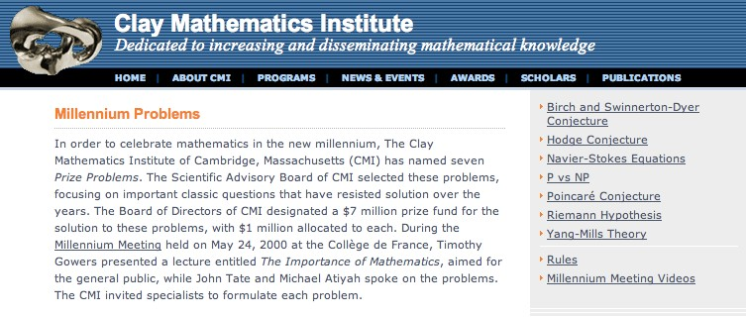

Slide 38
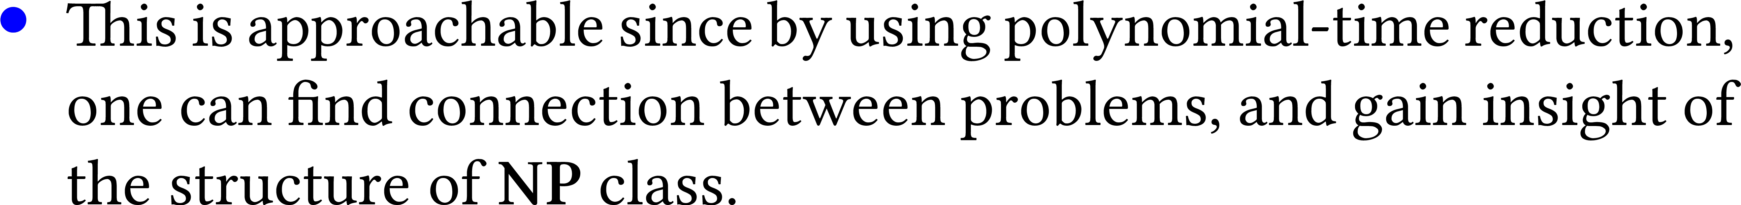

Slide 39

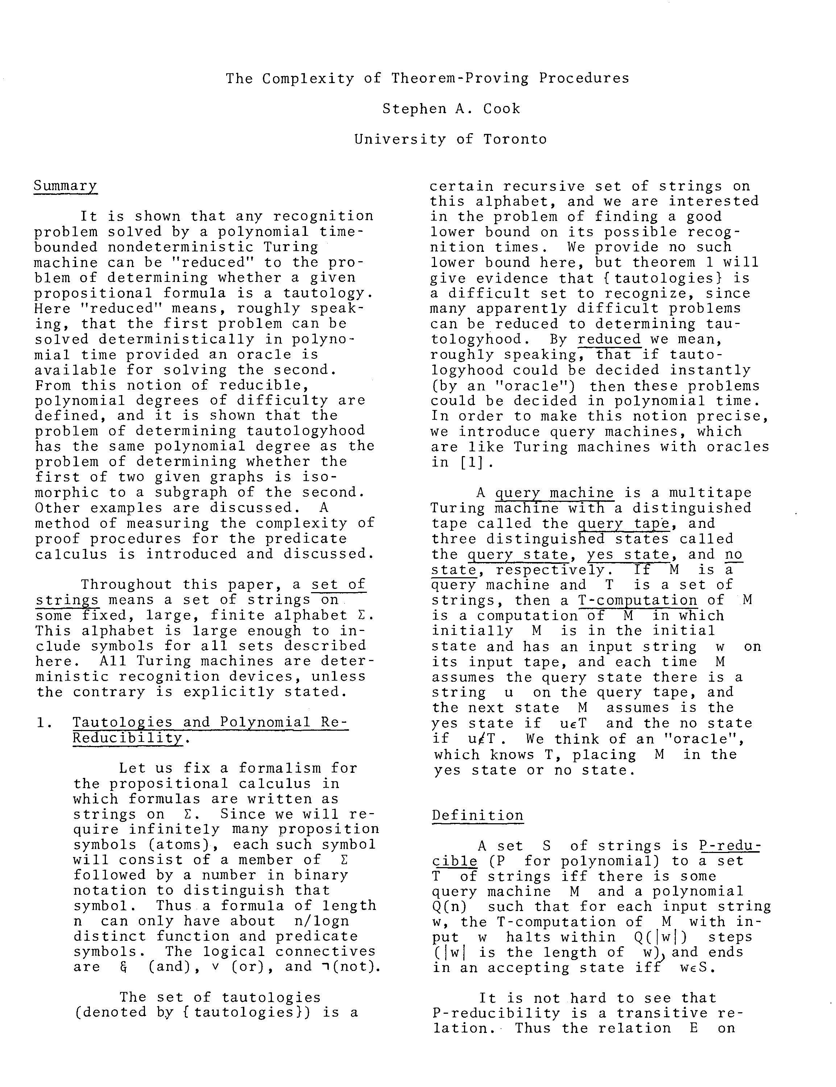

Slide 40


Slide 41

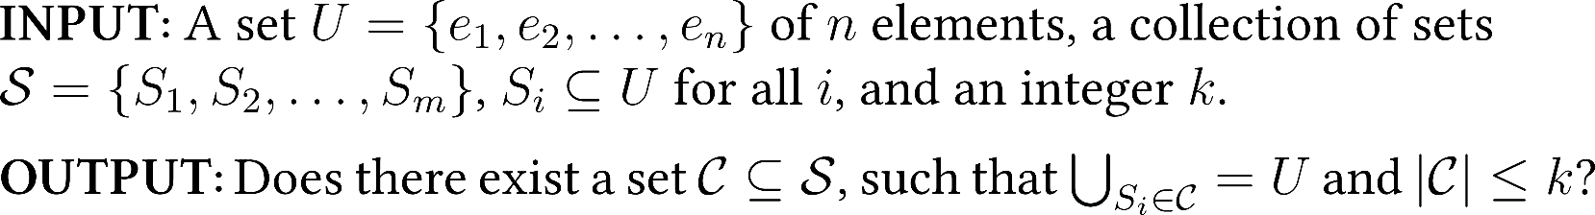
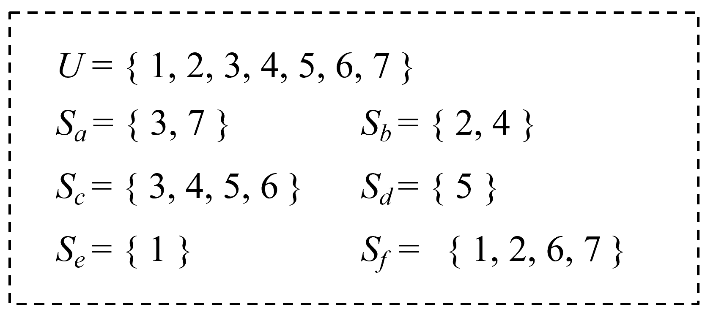
Notes:
http://www.cs.yale.edu/homes/aspnes/pinewiki/SubsetSumReduction.html?highlight=%28CategoryAlgorithmNotes%29

Slide 42
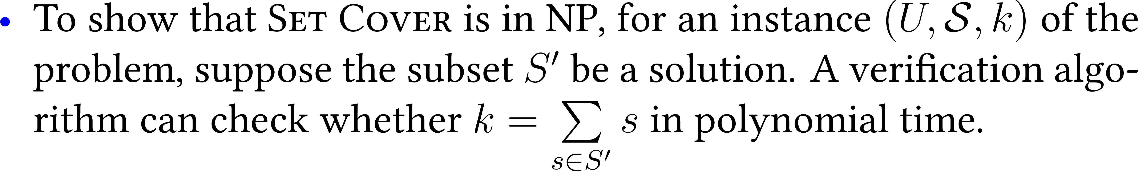

Slide 43


Slide 44
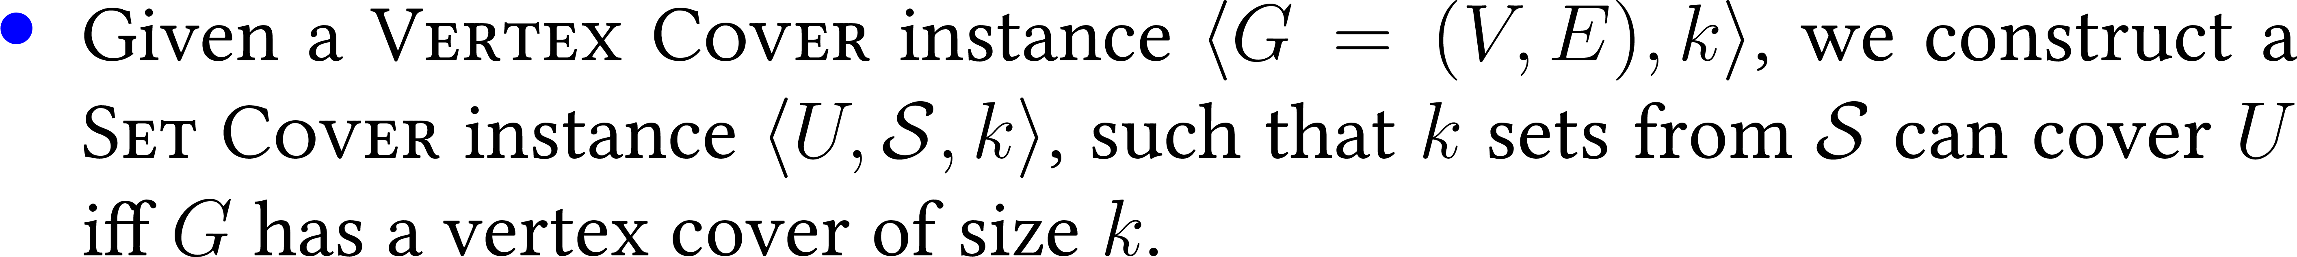

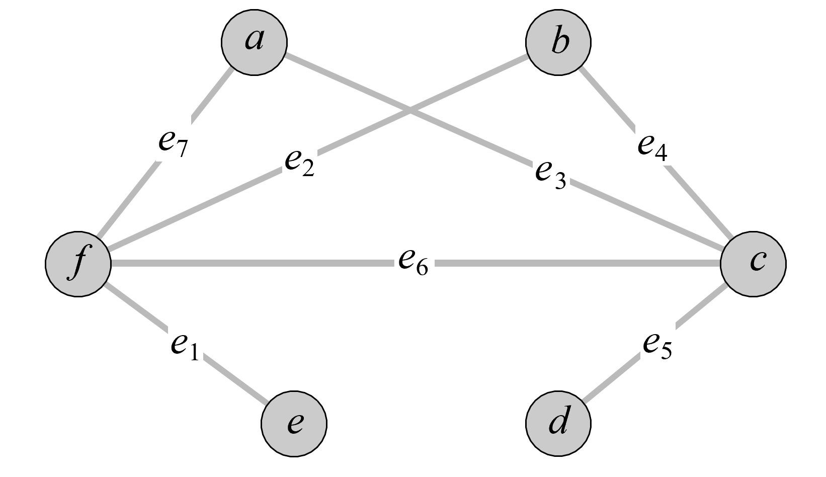

Slide 45

f
c

Slide 46

f
c

Slide 47
Notes:
http://www.cs.yale.edu/homes/aspnes/pinewiki/SubsetSumReduction.html?highlight=%28CategoryAlgorithmNotes%29

Slide 48
quiz
Suppose that X ∈ NP-COMPLETE, Y ∈ NP, and X ≤ _{P} Y. Which can you infer?
A. Y is NP-complete.
B. If Y ∉ P, then P ≠ NP.
C. If P ≠ NP, then neither X nor Y is in P.
D. All of the above.
recipe for proving that Y is NP-complete
Y is NP-complete
X and Y are NP-complete

Slide 49
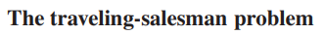
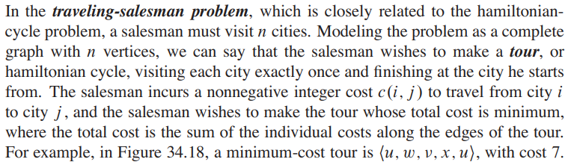
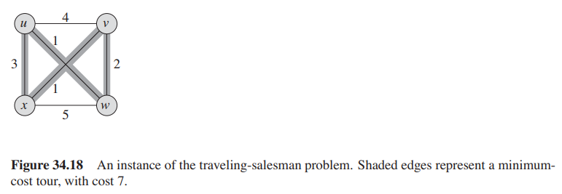

Slide 50
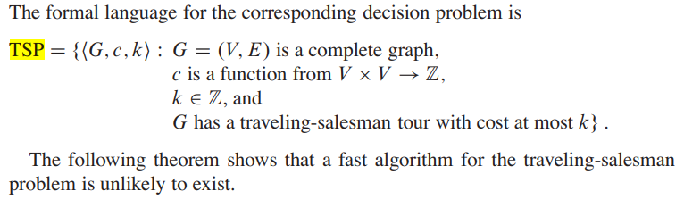
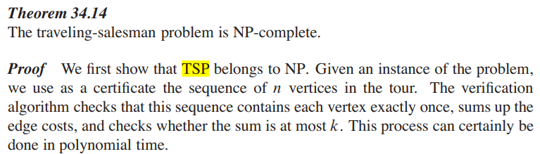

Slide 51
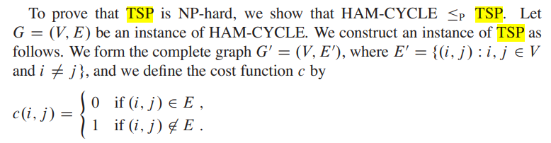
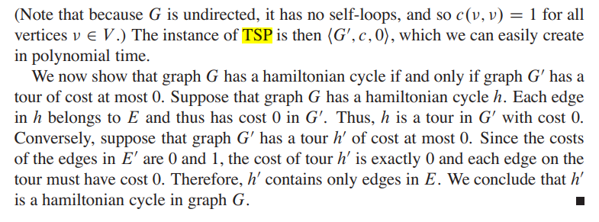

Slide 52


Slide 53

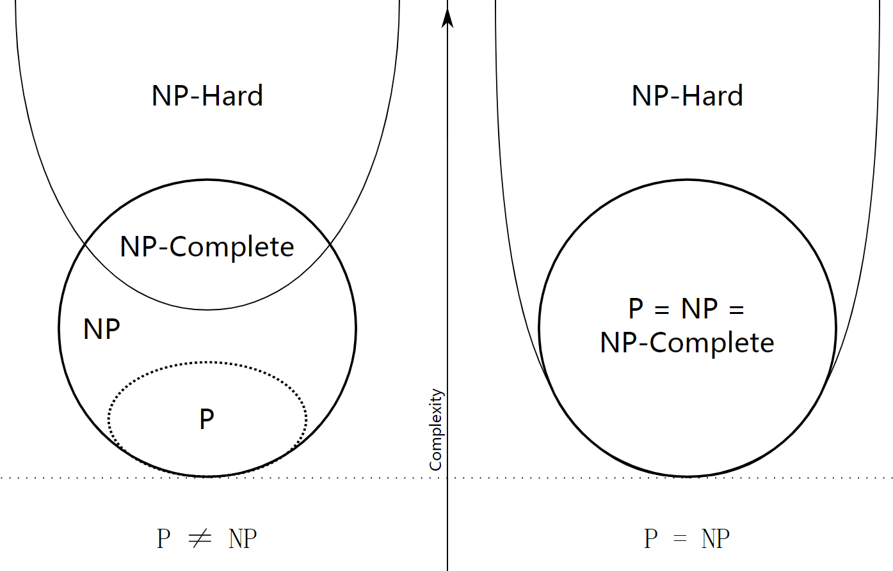

Slide 54


